Slide 1
Registers

Slide 2
Registers
Flip flops can be used to store a single bit of binary data (1or 0). However, in order to store multiple bits of data, we need multiple flip flops. N flip flops are to be connected in an order to store n bits of data.
A Register is a device which is used to store such information. It is a group of flip flops connected in series used to store multiple bits of data.
The information stored within these registers can be transferred with the help of shift registers.

Slide 3
Shift Register
Shift Register is a group of flip flops used to store multiple bits of data.
The bits stored in such registers can be made to move within the registers and in/out of the registers by applying clock pulses.
An n-bit shift register can be formed by connecting n flip-flops where each flip flop stores a single bit of data.
The registers which will shift the bits to left are called “Shift left registers”.
The registers which will shift the bits to right are called “Shift right registers”.

Slide 4
Types of Shift Register
Serial In Serial Out shift register
Serial In parallel Out shift register
Parallel In Serial Out shift register
Parallel In parallel Out shift register

Slide 5
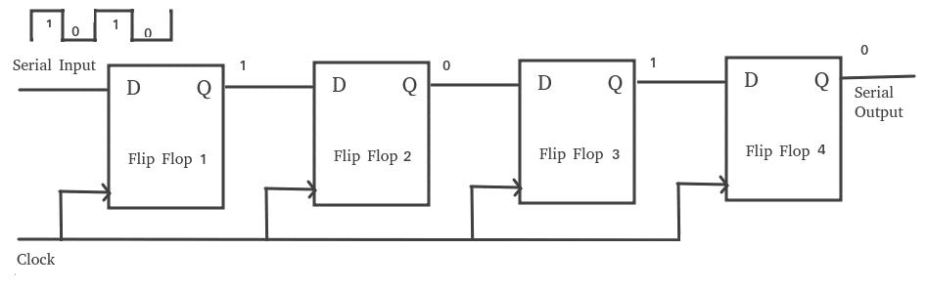
Serial-In Serial-Out Shift Register (SISO)
The shift register, which allows serial input (one bit after the other through a single data line) and produces a serial output is known as Serial-In Serial-Out shift register.
Since there is only one output, the data leaves the shift register one bit at a time in a serial pattern, thus the name Serial-In Serial-Out Shift Register.
The main use of a SISO is to act as a delay element

Slide 6
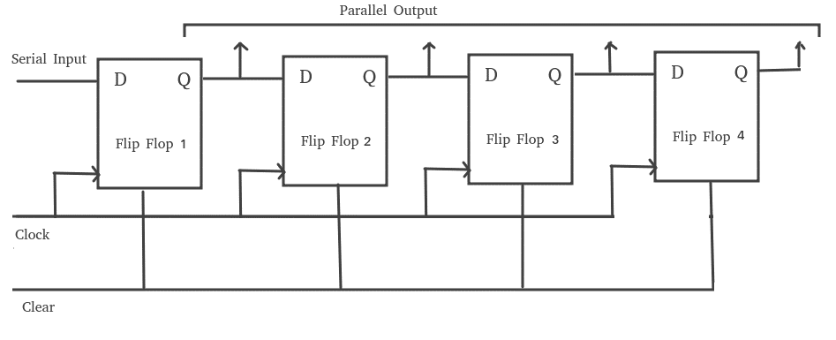
Serial-In Parallel-Out shift Register (SIPO)
The shift register, which allows serial input (one bit after the other through a single data line) and produces a parallel output is known as Serial-In Parallel-Out shift register.
The circuit consists of four D flip-flops which are connected.
The clear (CLR) signal is connected in addition to the clock signal to all the 4 flip flops in order to RESET them.
The output of the first flip flop is connected to the input of the next flip flop and so on. All these flip-flops are synchronous with each other since the same clock signal is applied to each flip flop.
This circuit is an example of shift right register, taking the serial data input from the left side of the flip flop and producing a parallel output.
They are used in communication lines where demultiplexing of a data line into several parallel lines is required because the main use of the SIPO register is to convert serial data into parallel data.

Slide 7
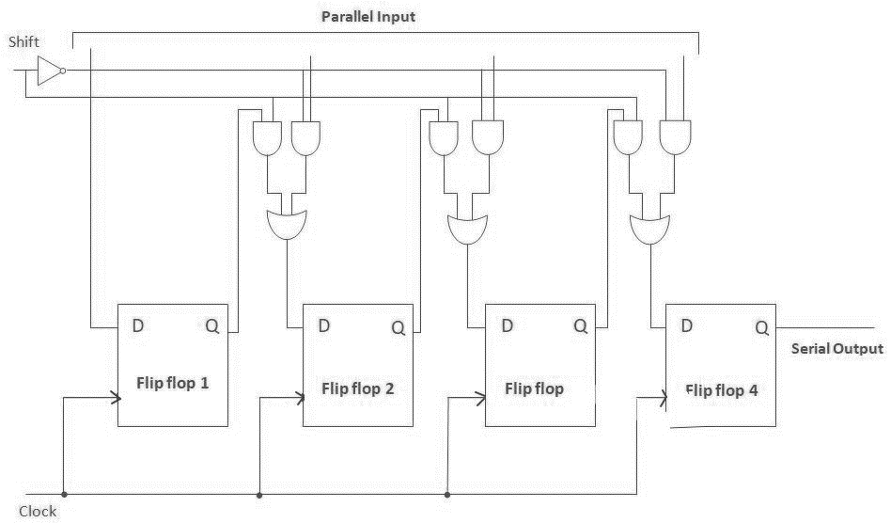
Parallel-In Serial-Out Shift Register (PISO)
The shift register, which allows parallel input (data is given separately to each flip flop and in a simultaneous manner) and produces a serial output is known as Parallel-In Serial-Out shift register.
The circuit consists of four D flip-flops which are connected.
The clock input is directly connected to all the flip flops but the input data is connected individually to each flip flop through a multiplexer at the input of every flip flop.
The output of the previous flip flop and parallel data input are connected to the input of the MUX and the output of MUX is connected to the next flip flop.
All these flip-flops are synchronous with each other since the same clock signal is applied to each flip flop.
A Parallel in Serial out (PISO) shift register us used to convert parallel data to serial data.

Slide 8
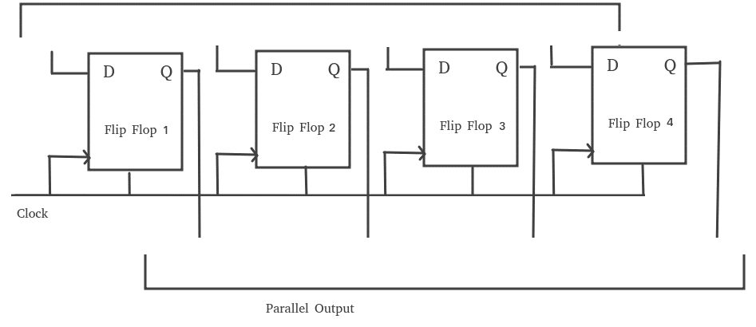
Parallel-In Parallel-Out Shift Register (PIPO)
The shift register, which allows parallel input (data is given separately to each flip flop and in a simultaneous manner) and also produces a parallel output is known as Parallel-In parallel-Out shift register.
The circuit consists of four D flip-flops which are connected.
The clear (CLR) signal and clock signals are connected to all the 4 flip flops.
In this type of register, there are no interconnections between the individual flip-flops since no serial shifting of the data is required.
Data is given as input separately for each flip flop and in the same way, output also collected individually from each flip flop.
A Parallel in Parallel out (PIPO) shift register is used as a temporary storage device and like SISO Shift register it acts as a delay element.

